Slide 1


Magnetic Random Access Memory
Longlong Zhang
2019.11.25

Slide 2
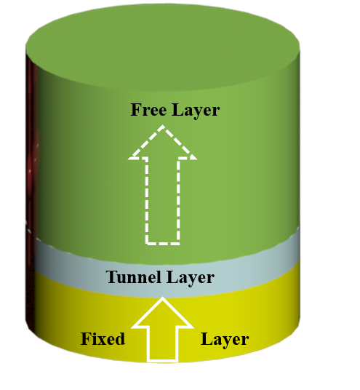
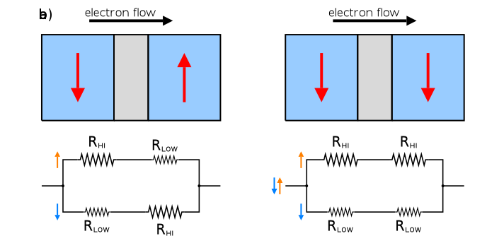
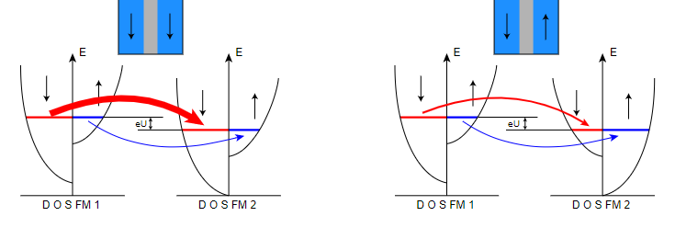
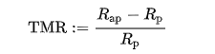
Part 1 Basic theory of MRAM
Fig 0 MRAM model
Fig 1 A simple model of GMR effect
Fig 2 A simple model of TMR effect
Note: GMR and TMR are based on the huge resistance difference between parallel and anti parallel states

Slide 3
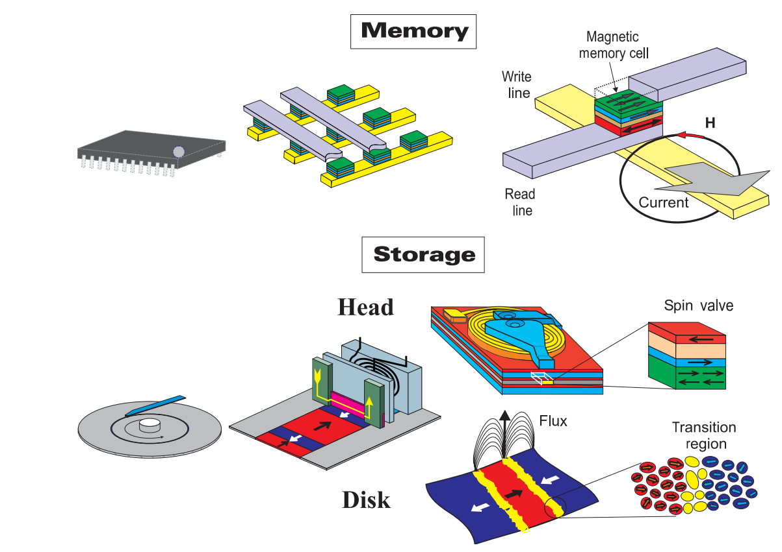
Part 2 The Application Of MRAM

Slide 4
The development of MTJ from 2000 to 2004
Year | Area(um) | substrate | seed layer | AFM（nm) | PL(nm) | tunnel(nm) | FL(nm) | Cap layer (nm) | Methods | TMR（室温） | 参考文献 | Author
1999 | 2*3 |  | Ta(7) | MnRh(17）/ | NiFe(10)/CoFe(2) | Al2O3(4) | CoFe(4) | Ta(3） | Sputter | 27% | 1999Al-0终结
2000 |  | Si(100) | Pd(15)/Ti(5) | MnIr(16) | CoFe(2.4) | Al-O(1.3) | CoFe(3) | Pd(1.5) | Sputter |  | 2000 MnIr
2000 | 6*6 |  |  |  | LaCaMnO3 | NdGaO | LaCaMnO3 |  | PLD | 86%(77K)小 | 2000半金属
2000 | 10*10 | Si(111) | Cr(1.6)Fe(6)/Cu(30) |  | Co(1.8)/Ru(0.8）/CoFe(3) | Al2O3(1.5) | CoFe(1)/Fe(6) | Cu(10)/Cr(5) | MBE | 30%(300k） | 2000人工材料
2001 | 10*10 | GaAs（001） |  |  | Fe(20) | MgO(2) | CoFe(25) |  | Sputter/LA | 27%（300k) | 2001 MgO | Martinez Bou´beta
2001 | 10*10 | SI(001) | Ta(3.5)/NiFe(2) | MnIr(8) | NiFe(4)/Co(2) | Ta2O5(1.8) | Co(2)/NiFe(6) | Ta(3.5) | Sputter | 10%（300k) | 2001TaO
2001 | 200*200 | GaAs（001） |  |  | Ga1-xMnxAs(50) | AlAs(1.6) | Ga1-xMnxAs(50) |  | MBE | 70%(8k) | 2001半导体MTJ
2002 | 1*2 | STO(001) |  |  | La2/3Sr1/3MnO3(35) | SrTiO3(2.8) | La2/3Sr1/3MnO3(100) | Au(15) | PLD | 1800%（4k) | 2002LaSrMnO
2002 | 100*200 | MgO(100) |  |  | Fe(50) | MgO(1) | Fe(5）/Co(50) | Pd(10) | MBE | 17%（300k) | 2002MgO | E. Popova,
2003 | 500*500 | MgO(100) |  |  | Fe(20) | Mg-O(2.6) | FeCo(20) |  | MBE | 23%(4.2K) | 2003MgO
2003 | 69*95 | MgO(100) |  |  | Fe(50） | MgO(2.5) | Fe(5)/Co(50) | Au(10) | MBE | 67%(300k) | 2003MgO2 | E. Popova,
2003 | 3*3 | SiO2 | Ru(30) | MnIr(8) | CoFe(2.5) | Y-O(1.5) | CoFe(1)/Py(5） | Ru(10) | Sputter | 25%（300k) | 2003YO
2004 | 500*500 | MgO(110) | Au(10) |  | FePt(18) | Al-O（4.5） | CoFe(20) |  | Sputter/EBE | 34%(70K) | 2004FePt
2004 | 200*200 | SiO2 | V(42） | /MnIr(10) | Co2MnSi（100) | Al-O（1.8） | CoFe(5.1） | Cu(40)/Ta(5)/Au（40) | Sputter | 33%(300k) | 2004heusler
2004 | 3*12 | MgO（001) | MgO |  | Fe(50) | MgO | Fe(10）/Co(10) |  |  | 88%(300K)
2004 |  | MgO(001) |  |  | Fe | MgO(2.5) | Fe |  | MBE | 180%（300k） | 2004mgo Nature
2004 |  | Si（100) | Si3N4/Ru | / CrMnPt | CoFeB | Al2O3 | CoFeB/Ru/FeCo |  | Sputter | 70%（300k) | 2004 CoFeB

Slide 5
The development of MTJ from 2000 to 2005
Year | Area(um) | substrate | seed layer | AFM（nm) | PL(nm) | tunnel(nm) | FL(nm) | Cap layer (nm) | Methods | TMR（室温） | 参考文献 | Author
2004 | 500*500 | MgO(110) | Au(10) |  | FePt(18) | Al-O（4.5） | CoFe(20) |  | Sputter/EBE | 34%(70K) | 2004FePt
2004 | 200*200 | SiO2 | V(42） | /MnIr(10) | Co2MnSi（100) | Al-O（1.8） | CoFe(5.1） | Cu(40)/Ta(5)/Au（40) | Sputter | 33%(300k) | 2004heusler
2004 | 3*12 | MgO（001) | MgO |  | Fe(50) | MgO | Fe(10）/Co(10) |  |  | 88%(300K)
2004 |  | MgO(001) |  |  | Fe | MgO(2.5) | Fe |  | MBE | 180%（300k） | 2004mgo Nature | Shinji Yuasa
2004 |  | Si（100) | Si3N4/Ru | / CrMnPt | CoFeB | Al2O3 | CoFeB/Ru/FeCo |  | Sputter | 70%（300k) | 2004 CoFeB
2005 7.8 | 100*200 | Si | Ta(5) /CuN(20)/Ta（3） | PtMn(15) | CoFe(25)/Ru(0.85)/CoFeB(3) | Mg(0.4)/MgO（1） | CoFeB(3) | Ta(5) /CuN（20）/Ta（3） | Sputter | 234% | 2005AA1 | 360/2h/8k0e
2005 | 0.8*0.8 | Si | Ta(5) / Ru(50) / Ta(5) / NiFe(5) | MnIr(10) | CoFe(2) / Ru(0.8) /CoFeB(3) | MgO(1-2) | CoFeB(3) | Ta(5) / Ru(5) | rf Sputter | 260% | 2005AA2 | 375/1h/4koe
2005.10.19 |  |  |  |  |  |  |  |  | Sputter/EBE |  | 2005AA RHEED | 360
2005.8.31 | 1*1 | Si(100) | Ta(10) | PtMn(15) | CoFe(2.5) / Ru(0.85) /CoFeB(3） | MgO(1.8) | CoFeB(3) | Ta(10)/Ru(7) | Sputter | 315%(4k) | 2005AA4 | 360/2h/8k0e
2005.1.24 | 1*1 | Si(100) | Ta(10) | PtMn(15) | CoFe(2.5) / Ru(0.85) /CoFeB(3） | MgO(1.8) | CoFeB(2.5) | Ta(10)/Ru(7) | Sputter | 230% | 2005AA3 | 360/2h/8k0e
2005.10.5 | 3*12 | MgO(100) | MgO(20) | MnIr(10) | Fe(10) | MgO | Fe1−xCox(100) | Au(50) | MBE | 271% | 2005 E-MgO | Shinji Yuasa
2005 | 20*4 | GaAs(001) | GaAs(20) |  | Ga1−xMnxAs(30) | GaAs(1)/AlAs(1.5)/GaAs(1） | CrFe（35） |  | MBE | 14.5（4k) | 2005AlAs
2005 | 200*200 | Si/SiO2 |  |  | Pd （1–30）/Co（0.5） | AlOx | Co 0.3/Pd 2 |  | Sputter | 12.60% | 2005 Co-Pd
2005 | 10*10 | GaAs | GaAs |  | Ga1- xMnxAs（50） | ZnSe（1） | Ga1-xMnxAs（50) |  | MBE | 100%(2k) | 2005 半导体化合物
4

Slide 6
Conclusion:
1.The High TMR ratio of MgO-barrier MTJ based a solid foundation for the future development of MRAM device.
2.After the year of 2007 ,most of groups are satisfied with the TMR ratio of MRAM and changed their research direction to improve other aspects of MRAM performance.

Slide 7
The development of MTJ from 2007 to 2019
Apart from the TMR ratio , device area ,switching time , and write error rate are also vital aspects of MRAM.
STT
SOT
VCMA
…
Switching time
Magnetoelectric coupling
device area
1998
TMR Ratio
2007
TMR Ratio
Out of plane magnetization MRAM
Dual interface MRAM
PSA –MRAM

Slide 8
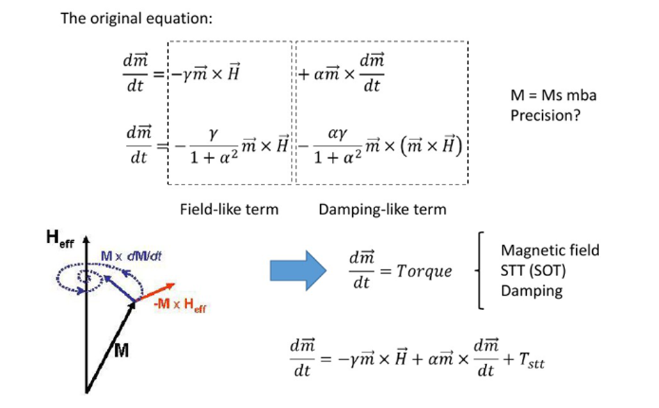
LLG Equation

Slide 9
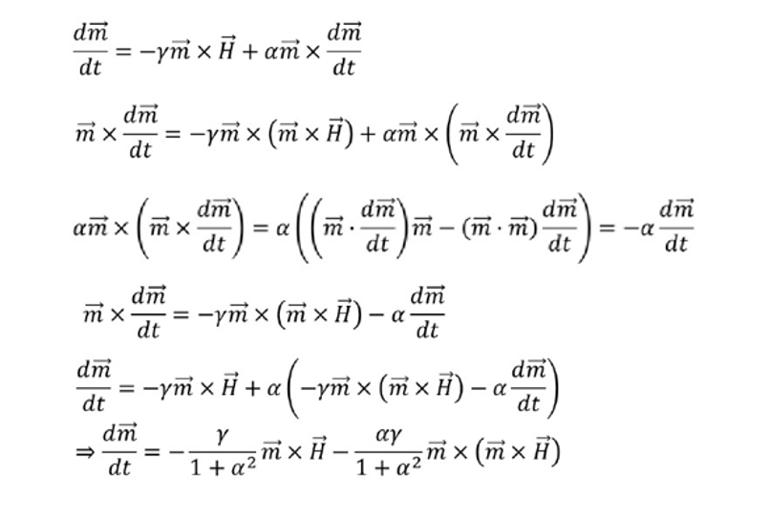
LLG Equation(2)
Transformation of the two expression

Slide 10
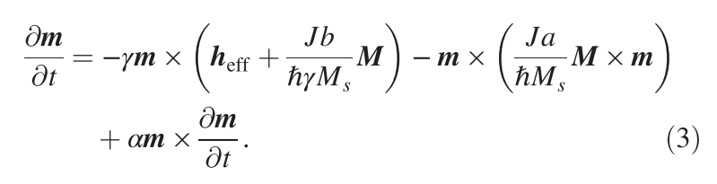
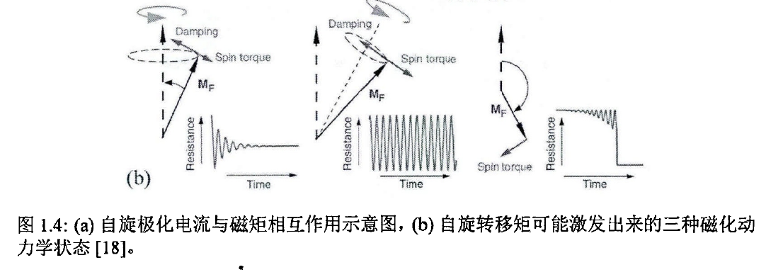
LLGS Equation

Slide 11
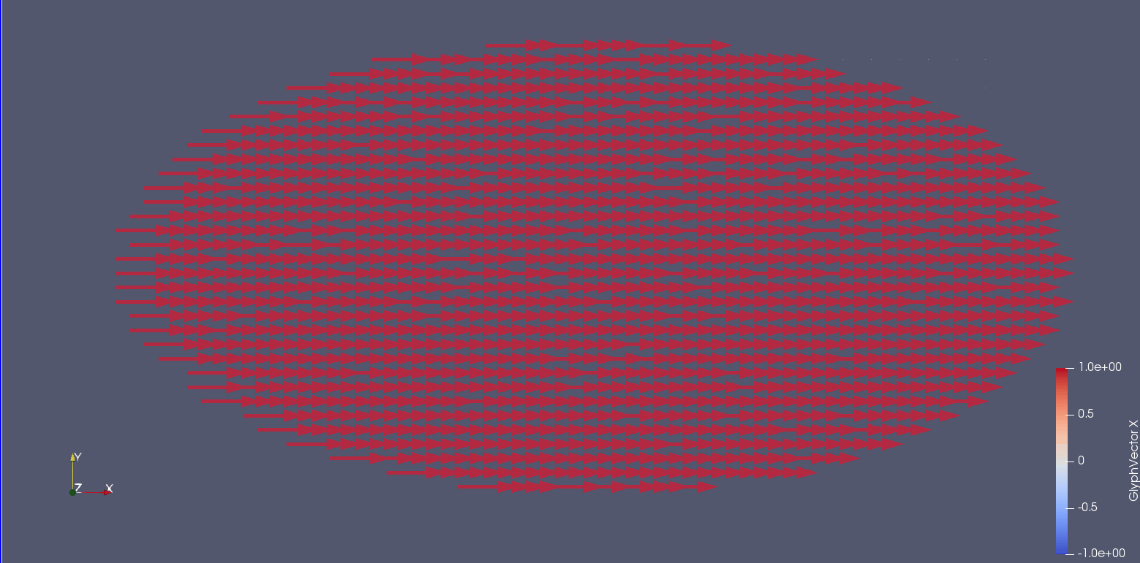
STT Simulation

Slide 12
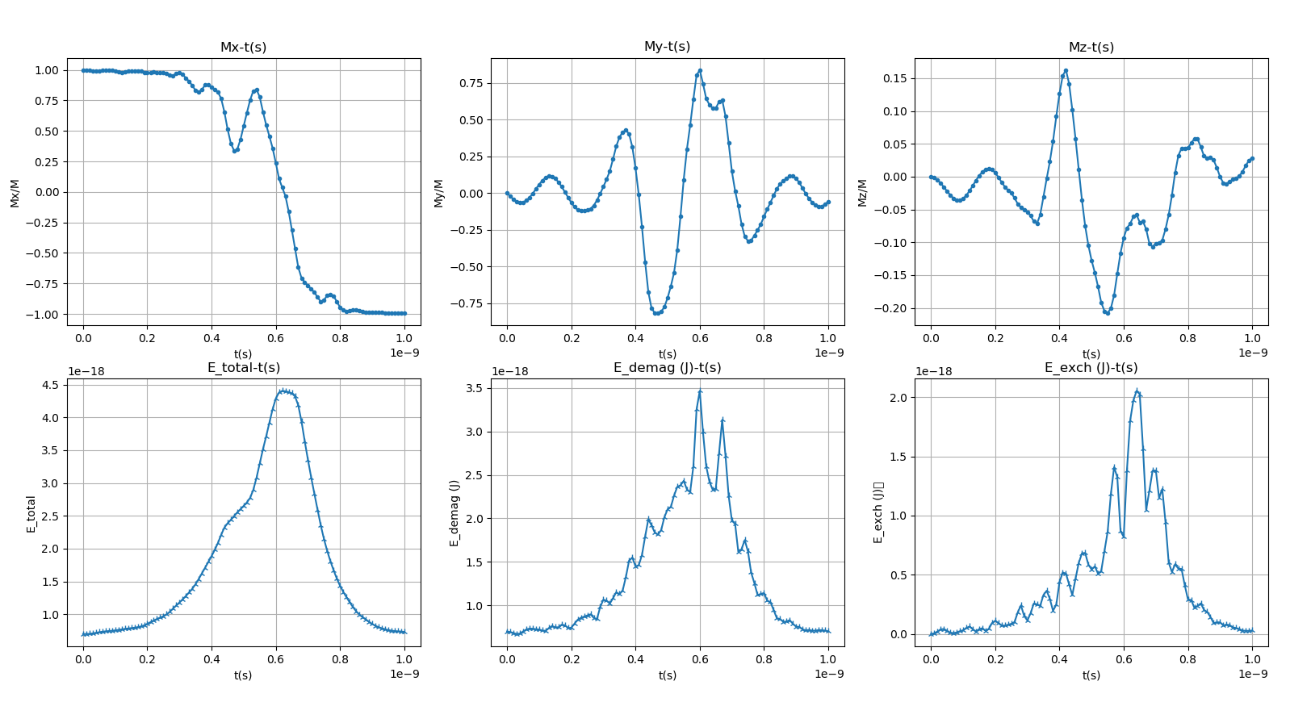
STT Simulation(2)

Slide 13
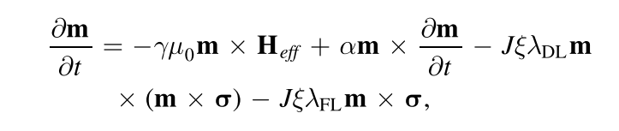
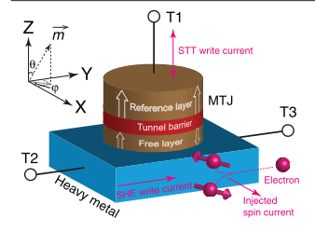
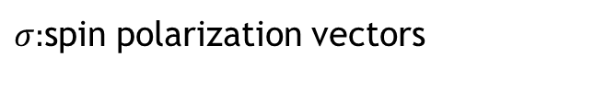
SOT Effect
STT
SOT
$σ:$spin polarization vectors
Nanotechnology 30 (2019) 375202

Slide 14
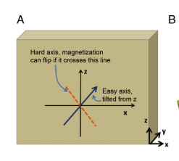
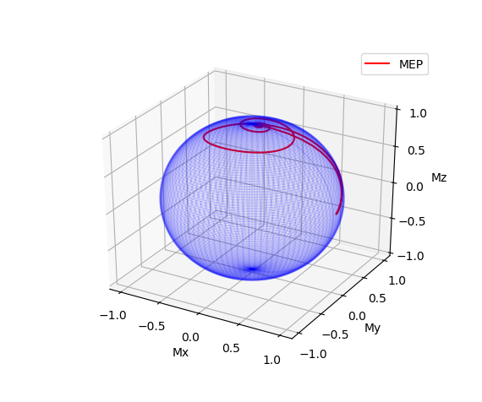
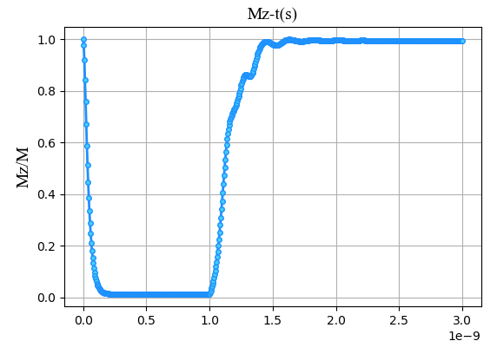
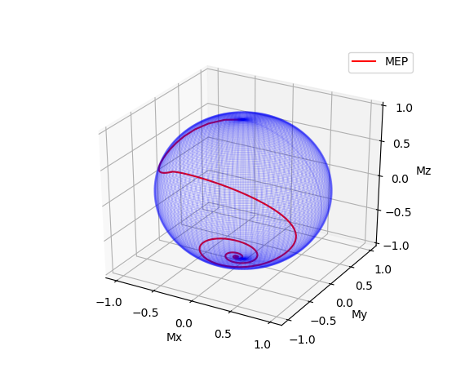
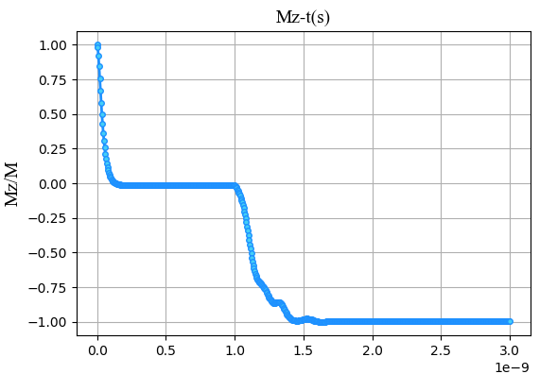
SOT simulation
Model 2 Anisotropy(1, 0, 100) Fixed later (-1, 0 ,0)

Slide 15
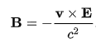
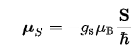
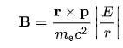
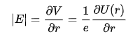
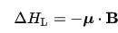
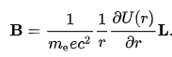
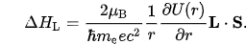
SOC Coupling
In quantum physics, the spin–orbit interaction (also called spin–orbit effect or spin–orbit coupling) is a relativistic interaction of a particle's spin with its motion inside a potential.
Magnetic field
magnetic moment of the electron
The energy of a magnetic momen

Slide 16
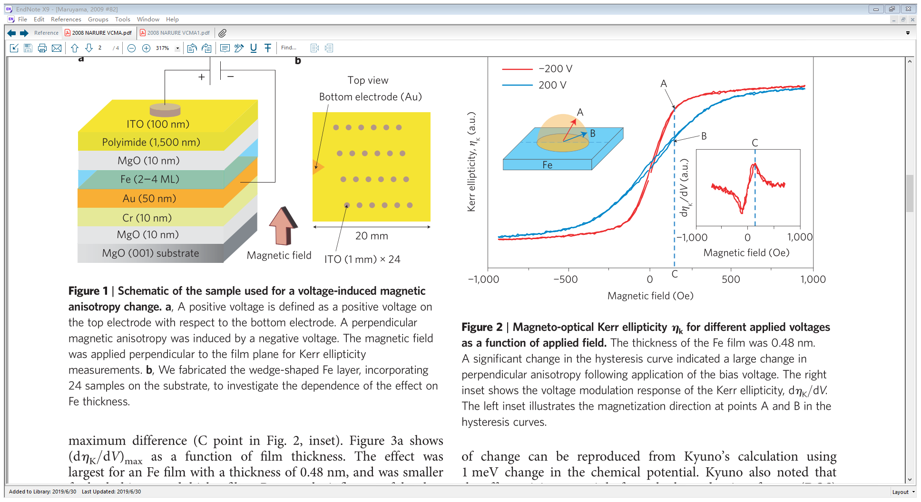
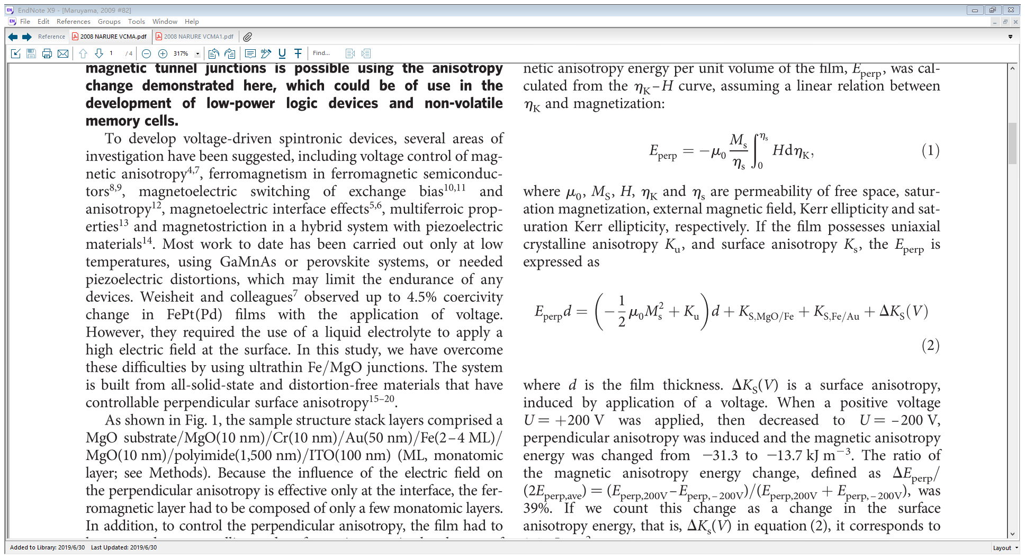
Voltage Control Magnetic Anisotropy
Figure 1 | Schematic of the sample used for a voltage-induced magnetic anisotropy change
NATURE NANOTECHNOLOGY | VOL 4 | MARCH 2009

Slide 17
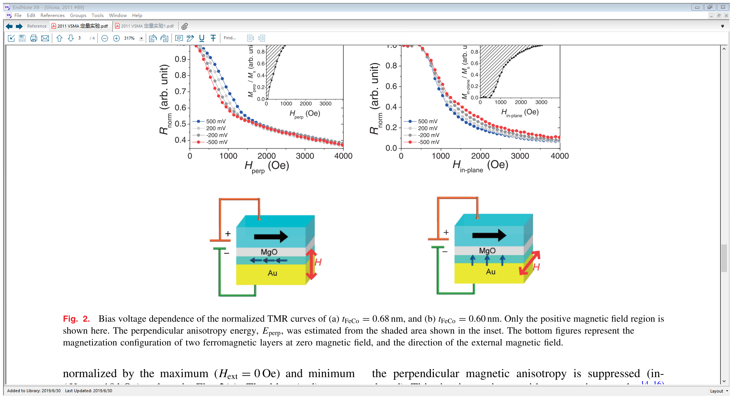
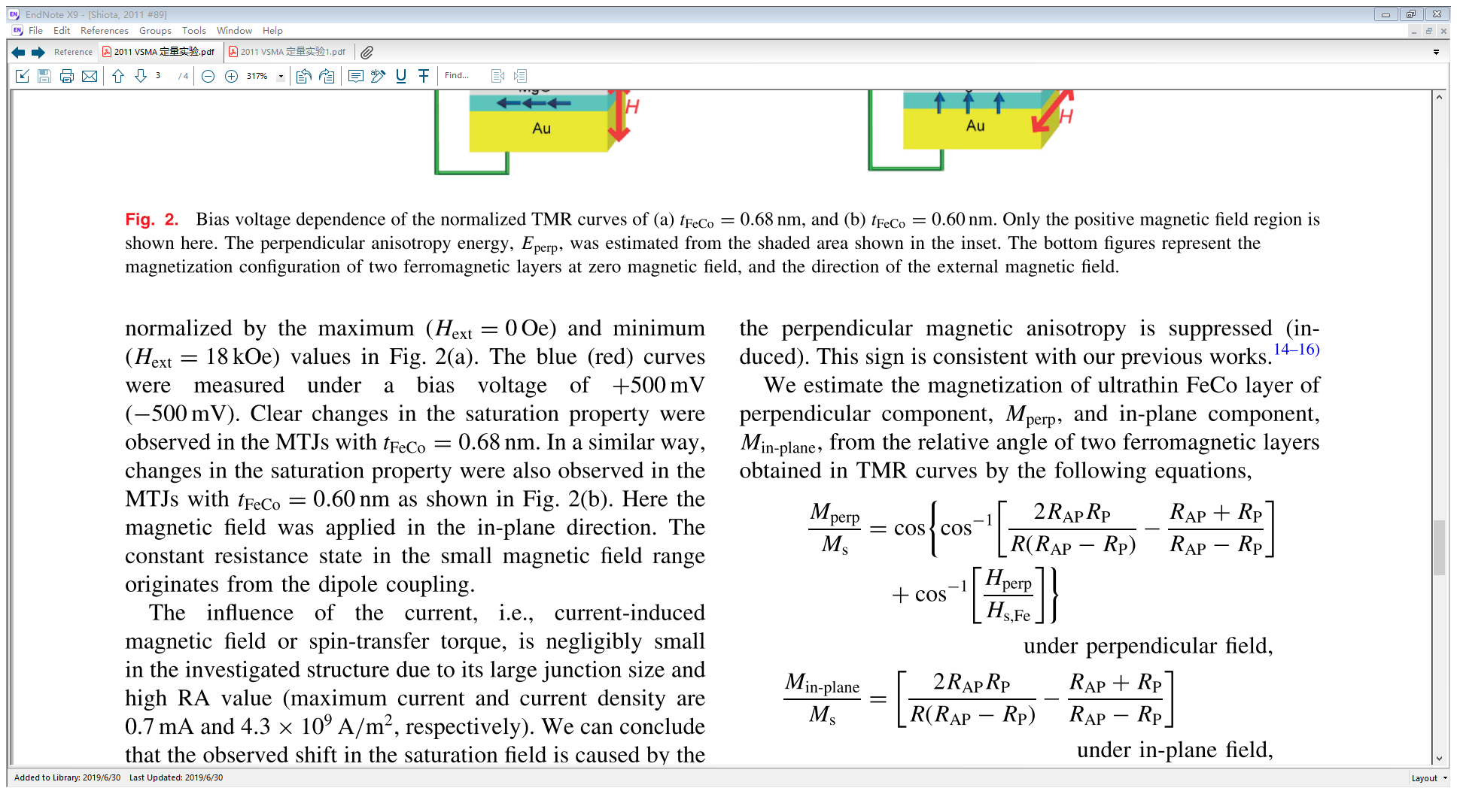
Voltage Control Magnetic Anisotropy（2）
2011 The Japan Society of Applied Physics

Slide 18
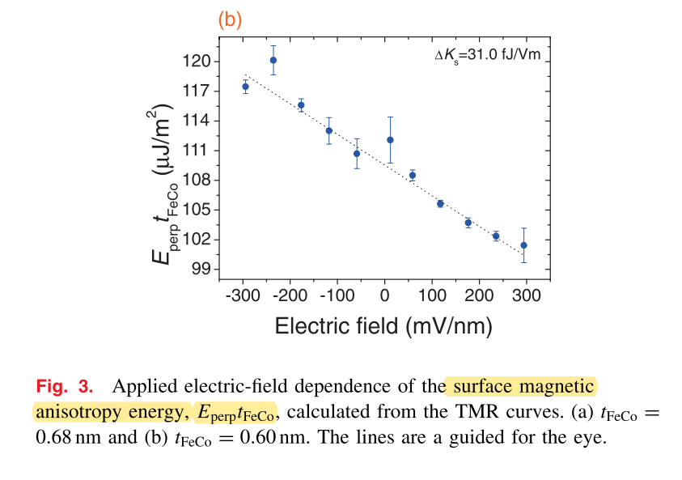
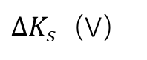
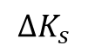
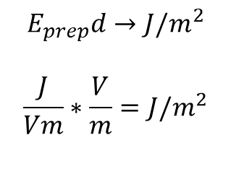
Voltage Control Magnetic Anisotropy（3）
$$E_{prep}d→J/m^{2}$$
$$\frac{J}{Vm}∗\frac{V}{m}=J/m^{2}$$
$$∆K_{s}$$
E
$∆K_{s}（$V）

Slide 19
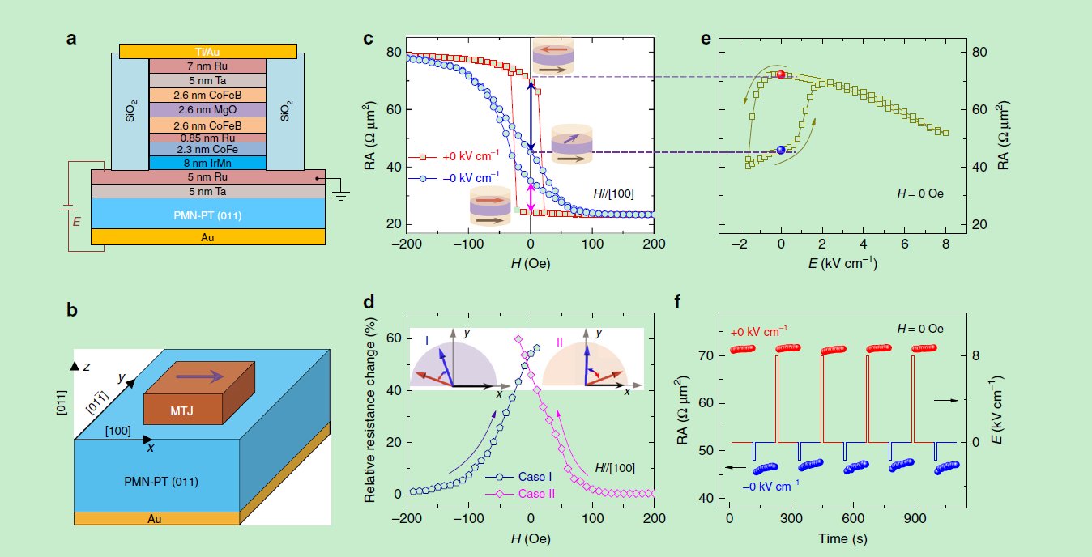
Magnetoelectric coupling
ABSTRACT:A giant, reversible and nonvolatile electric-field manipulation of magnetoresistance to
about 55% is realized at room temperature without the assistance of a magnetic field.

Slide 20
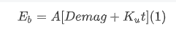
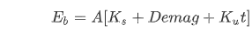
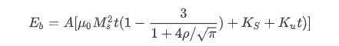
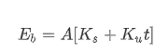
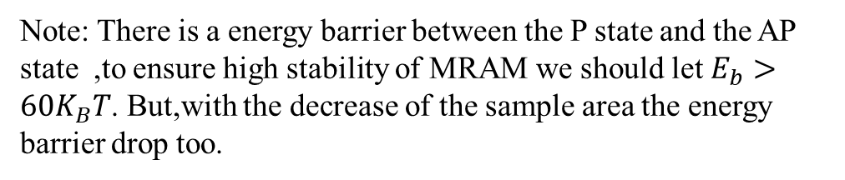
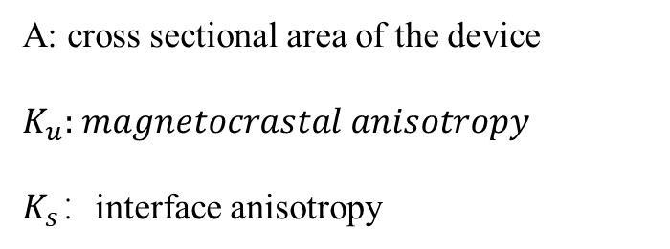
Device Area
MTJ
P-MTJ
Huge Demage
PSA-MTJ
Note: There is a energy barrier between the P state and the AP state ,to ensure high stability of MRAM we should let $E_{b}>60K_{B}T$. But,with the decrease of the sample area the energy barrier drop too.
A: cross sectional area of the device
$K_{u}:$ $magnetocrastal anisotropy$
$K_{s}：$interface anisotropy

Slide 21
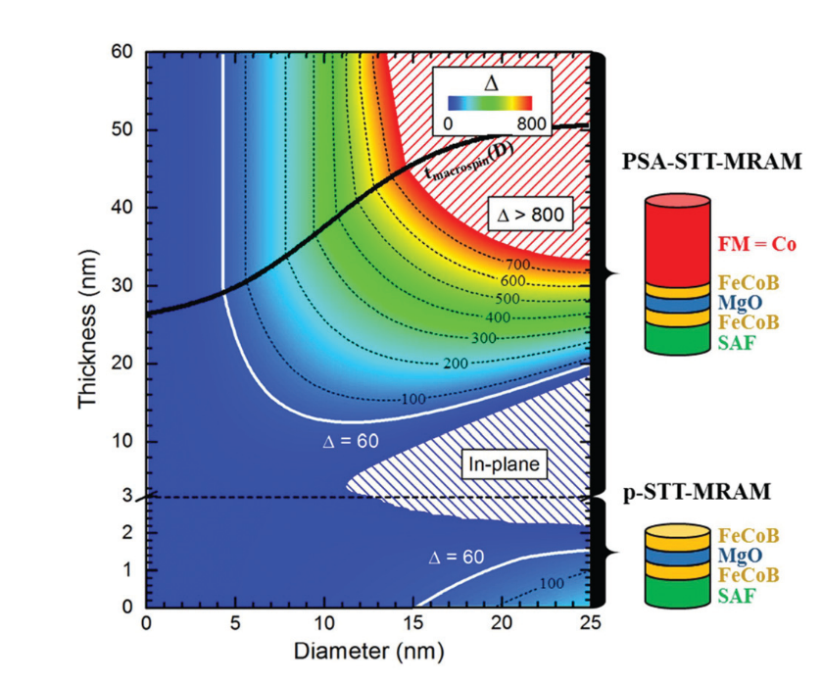
Device Area (2)

Slide 22
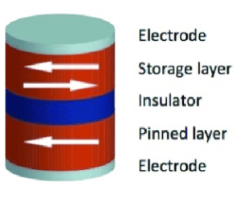
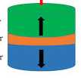
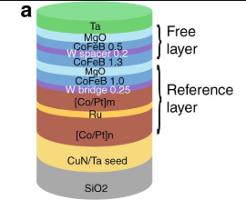
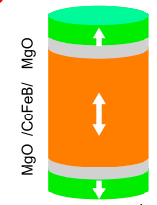
Device Area(3)
MTJ
P-MTJ
Dual interface MTJ
PSA-MTJ
Dual interface PSA MTJ
Time Direction

